Slide 1
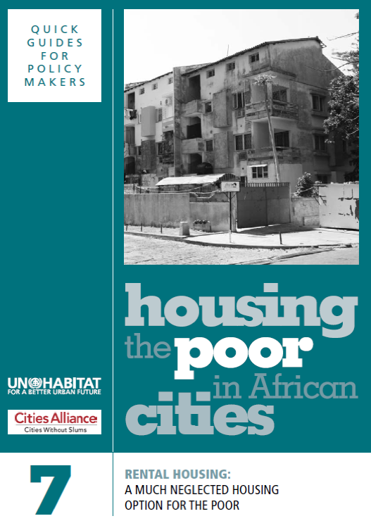
Rental housing

Slide 2
Learning Outcomes
Participants will be able to:
Explain what rental housing is and why people rent
Understand informal rental markets
Discuss key aspects of rental housing, such as access, supply and landlords
Assess to which needs rental housing should respond
Understand challenges of rental housing regulation
Identify policies to promote rental housing
2

Slide 3
Structure of the Module
Types of and prevalence of rental housing
Reasons for renting
Informal rental housing
Access to and supply of rental housing
Landlords
Factors for good rental housing
Level of rent
Challenges faced by rental housing regulation
Policies to promote rental housing
3

Slide 4
Extent of Rental Housing
‘Rental housing today makes up a large proportion of the urban housing stock in many African countries’
In Kisumu, Kenya, 82 per cent of households were living in rental accommodation in 1998
In Addis Ababa, Ethiopia, the figure was 60 per cent of households
In Kumasi, Ghana, the figure was 57 per cent of households
>>Questions:
What is the situation in your country?
Is the percentage increasing?
If yes, why?
4

Slide 5
Small-scale Rental Housing
‘The housing that small-scale landlords supply may come in the form of cheap rental rooms, apartments of various sizes, or rooms built with substandard construction on illegally subdivided land or partitioned within dilapidated older buildings. It could be a shack, a room built in a slum or behind the owner’s house with shared services. It could be rented space within a shared room, or even the right to store one’s belongings and occupy a certain space within a shared room for part of the day’
>>Questions:
Is this the situation in your country?
Is there anything you would add?
5

Slide 6
Rental Housing’s Poor Image
‘Rental housing suffers from a negative reputation: landlords are often perceived as being exploitative and only too happy to offer crowded and substandard housing at the highest price they can squeeze from the vulnerable poor. Rental housing, especially at the lower end of the market, has also often been seen as being shrouded in illegality and as contributing to inner-city decay. The frequent eviction of tenants and their mobility have likewise been seen as potential sources of civic unrest.’
>>Questions:
Is this a common perception?
Is it justified?
6

Slide 7
Why People Rent
Because they can’t afford to buy
Renting lets people stay mobile
Gives people flexibility in how they manage their household budgets
Suits people during transition periods
Convenient for households who don’t want to make a long-term financial commitment
Allows people to send more of their earnings home to relatives or to invest in other things
7

Slide 8
Eight Myths About Rental Housing
Everyone owns their homes in rich countries
Everyone wants to be a homeowner
Home ownership offers people a better life
Nobody invests in rental housing
Renting is inequitable
Governments should prohibit poor quality rental housing
Mobility is bad for the poor
Home ownership encourages the emergence of a politically-stable society
>>Question:
Are these valid points?
8

Slide 9
Unreliable Urban Rental Statistics
’It is difficult to collect and compile comparable data on rental housing’
    >>Questions:
    Why is this the case and what is the role of informal rentals?
How does this affect policy decisions and what can be done to improve statistics?
9

Slide 10
The Contribution of Family Houses
‘Policy makers…should be mindful of the major contribution which family houses make in housing those on low incomes, and act to encourage and enable maintenance and provision of such housing rather than acting as if it is a vestige of a bygone age, of little relevance to the modern city’
>>Questions:
What are the advantages of family houses?
What is the attitude of policy makers in your country?
What can/should policy makers do to encourage and enable the provision of family houses?
10

Slide 11
Why Rental Housing Tends to be Invisible
It is often hard to distinguish rental housing from owner-occupied housing
Rental housing is dispersed all over the city
It is hard to distinguish landlords from their tenants
Both landlords and tenants often keep their rental relationships quiet
11

Slide 12
Supply of Rental Housing
‘Large-scale government-built housing has generally been negligible in African countries’
‘The private sector…has come to be the major producer of most urban rental housing…sometimes supported by the state’
>>Questions:
Is this so in your country?
What are the reasons for little public rental housing?
What are the consequences?
12

Slide 13
How People Access Rental Housing
Through open markets: accessed directly by anybody who can afford the stated rent and is willing to abide by the landlords’ conditions
Through relationships: providing temporary, often rent-free housing to relatives from the village
Through occupation: such as provision of basic housing to construction workers, domestic workers, factory workers and so on
13

Slide 14
Migrants From Rural Areas and Rental Housing
Sharing of rented rooms
Renting out sleeping spaces in storerooms, guest houses and hostels
Building additional and unauthorized rooms in backyards of sites and services schemes
Sharing with relatives
Moving to peripheral villages and towns
Land invasions
>>Question:
Any other ways?
14

Slide 15
Who are the Landlords?
Household landlords: often for extra cash
Commercial landlords: operating in a more professional way, but include ‘slum landlords’
Public sector landlords: including government departments and land-owning agencies, often covering purpose-built social housing for low-income tenants
Employer landlords: providing rental rooms for their workers, or nurses or students, usually not for profit
15

Slide 16
Women as Landlords
‘Whether male or female landlords dominate the rental housing market depends greatly on local custom and on the demography of the city.’
>>Questions:
What is the situation in your city?
Why is that so?
Does landlordism offer income opportunities for women?
16

Slide 17
Tenants as Landlords
‘A housing cooperative is an association that collectively owns and/or rents and governs their housing on a not-for-profit basis. Ideally, it works on the basis of providing affordable ownership of housing for its members. Credit and reference checks are carried out on all prospective members. They are required to attend information and training sessions before they can become members. Their membership gives them a share in the housing cooperative and they share the costs of financing and managing it. They have a right to live in housing owned by the cooperative...’
>>Questions:
Is this a good idea for the urban poor?
Why do you think such cooperatives have not been widespread in Africa?
17

Slide 18
Accommodation Needs: Quality of Rental Housing
Durability of the building materials: often housing for the urban poor is low-quality, weak and prone to maintenance problems
Level of maintenance: absentee landlords tend to take less care of maintenance
Level of crowding: low rental units have people squeezed in tight spaces
>>Question:
Are there other factors you can think of?
18

Slide 19
Accommodation Needs: Access to Jobs and Public Services
Proximity to places of employment, transport, markets, places of worship etc
Usually more available and more varied in inner-city locations
For urban poor, probably the most important factor
But commercial pressure is also greater in such inner-city locations
Informal settlements in peripheral areas tend to be close to growth centres, with eventual opportunities for jobs and services
>>Question:
Do you agree that location is the most important quality factor?
19

Slide 20
Accommodation Needs: Access to Basic Infrastructure
Access to utilities such as electricity, water and sanitation
Rental units in slums, squatter settlements and illegally subdivided tenement structures tend to have the greater access to basic services problems
Because such access usually depends on having legal status and house registration
So tenants are likely to have to share facilities, such as toilets and washing and cooking spaces
>>Question:
How valid are these points?
20

Slide 21
Accommodation Needs: Location and Social Support Systems
‘Uncertain and irregular employment, varying sources of income and unexpected expenditures can all force poor tenants to rely extensively on their families and on the informal support networks in their communities when crises occur...it is clear that the best place for the poor to live is near their social support networks.’
>>Question:
Do you agree with this argument?
If so, why?
If not, why not?
21

Slide 22
Accommodation Needs: Tenants’ Mobility Patterns
‘Moving in and out of cities has become an inherent part of life for many Africans – people move constantly between the city and the rural areas, or between different cities. Whether they come for higher education, to find a job, or to seek health care, most people will need flexible accommodation in the city which, most frequently, is provided in the form of rental housing.’
>>Questions:
Is this true?
If so, what are the consequences?
22

Slide 23
Accommodation Needs: Tenants’ Circumstances
Income level: when there is no long-term financial security, people tend to set aside money for investments other than in housing – such as paying for children’s education
Stage in life cycle: rental and sharing feature more often in early stages of people’s lives
Increase in female-headed households: often means more households that require flexible and affordable rental housing
23

Slide 24
Levels of Rent
‘Sometimes, rents make up a very high proportion of the tenant’s income but are nonetheless still too low for landlords to make a profit or even pay for maintenance of the property.’
>>Questions:
If there is such a mismatch, what are the consequences for individuals, housing supply, and maintenance of rental properties?
Are high rental deposits an issue in your countries?
24

Slide 25
Landlord-tenant Relationships
‘The landlords complain that their tenants don’t take good care of the rental housing, pay their rent late, misbehave in general and don’t understand that rising costs of utilities, maintenance and repairs make it necessary to raise the rent.
The tenants complain that their landlords fail to maintain the housing properly, don’t repair things when they break, charge unfairly high fees for utilities, increase the rent without warning, turn hostile when the rent is paid a little late, threaten eviction or fail to return security deposits when they move out.’
>>Questions:
Is such tension inevitable?
What can be done to improve the relationship?
25

Slide 26
How Much to Charge?
‘The 25 per cent rule: Some housing specialists suggest that rental housing is affordable if a household spends no more than 25 per cent of its monthly income on rent. This rule of thumb loses its meaning as you go down the economic ladder, where the only rule is that the poorer you are, the greater proportion of your monthly income you are likely to pay for housing and basic services.’
>>Questions:
What are the consequences?
Why is informal rental housing so prevalent in African cities?
26

Slide 27
Problems of Rent Controls
Equity: Some tenants are favoured at the expense of others – especially favouring long-term tenants over newcomers
No guarantee that those covered by rent controls are genuinely poor
Tenants gain at the expense of landlords
Efficiency: Landlords are discouraged from investing in rental property
Maintenance: Landlords fail to maintain the property- and houses deteriorate to slum conditions
27

Slide 28
Problems With Rental Regulations
Housing policies are often biased in favour of homeowners and fail to take needs of tenants into account
When rental housing conditions are poor, the problem is usually more to do with poor living conditions in general than with rental arrangements
Because much rental housing is invisible, it falls outside government regulations
Absence of enforceable written contracts and efficient arbitration systems leads to high costs of going to court for both tenants and landlords
28

Slide 29
Five Policy Options for Promoting Rental Housing
Acknowledge and understand existing rental practices
Get rental housing on the larger urban policy agenda
Work out practical, flexible rental policies and negotiations
Mobilize finance to improve and expand rental housing
Encourage large-scale and small-scale investment in rental housing
29

Slide 30
Conclusions
Rental housing is an important policy option in African cities
There are both formal and informal rental housing markets
There are problems with rental regulations
Governments can promote rental housing in different ways
30

