Slide 1
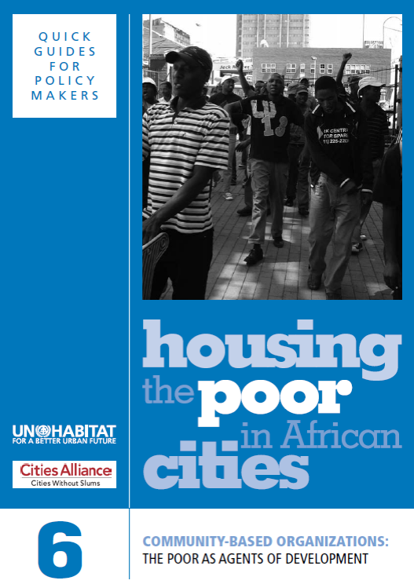

Slide 2
Learning Outcomes
Participants will be able to:
Discuss the role of community-based organizations (CBOs)
Explain different forms of participation
Identify ways how governments can work with and support CBOs to improve the living conditions of the poor
2

Slide 3
Structure of the Module
Definition of CBOs, and different roles and types of CBOs
Ownership of development process and poor communities as a resource
Government and civil society
How governments can work with CBOs to improve the living conditions of the poor
3

Slide 4
A Definition
‘These organisations…represent the urban poor, either the residents of particular geographical areas or people who share some common identity…As structures which allow poor households and poor communities to move from isolation and powerlessness into collective strength, these organizations have become powerful development mechanisms in their countries.’
>>Question:
Does this definition fit the CBOs in your own country?
4

Slide 5
CBO Types
Community development associations: negotiating access to urban services
Hometown associations: supporting new rural migrants and maintaining linkages with places of origin
Religious associations
Women’s groups: responding to specific challenges that women face
National federations of urban poor such as Shack/Slum Dwellers’ International (SDI)
Functions:
Agents for development; pro-poor advocates and protectors of rights
5

Slide 6
CBOs and NGOs
‘NGOs can be vital allies of community organizations by providing them with backup support in different ways. NGOs can also be a valuable link between the formal systems and the realities, common sense and confusion that constitute poor people’s lives. But the word from strong community organizations to their NGO partners is that communities can speak for themselves, and that communities need to engage with government organizations directly and not through NGOs.’
>>Questions:
What positive roles can NGOs play in their relationship with CBOs?
What negative ones do they sometimes play?
6

Slide 7
Ownership of Development Process
‘It is vital that in the long run, communities of the poor, as the main group seeking social justice, own and manage their own development process, and become central to its refinement and expansion.’ Sheela Patel, SPARC, India
>>Question:
Do you agree with this statement?
How can communities be supported in this?
7

Slide 8
The Poor as a Resource
‘The urban poor are the designers, builders and suppliers of the majority of affordable housing in Africa’s cities. Their self-help efforts have done what decades of government housing programmes, formal sector development projects, housing rights campaigns and international development interventions have failed to do: provide most of the urban poor with shelter and basic services – right now, when they need it, not in the distant future.’
>>Questions:
Is this a valid statement?
How should it affect the way we regard the residents of informal settlements as a resource?
8

Slide 9
Skills in the Communities
‘Informal communities already contain all the expertise that goes into building cities: bricklayers, carpenters, plumbers, electricians and labourers. When you add the confidence, skills, scale, innovation and organizational capacities that Africa’s community organizations have built, refined and scaled up over decades, you potentially have a large problem-solving resource at your disposal.’
>>Questions:
What role should community members and organisations play in the development of their communities?
What experience do you have in building the capacity of communities?
9

Slide 10
Housing Project Failures
‘Many African cities have a long history of housing project failures: subsidized housing developments that ended up housing the wrong target group, pilot projects that never scaled up, sites-and-services schemes where nobody wants to live and relocation projects abandoned to speculators, often after destroying viable communities through forced evictions.’
>>Questions:
Again, is this a valid statement?
Is this the case in your own country?
10

Slide 11
Self-reliance
‘For as long as human beings have been around, they have organized themselves into communities to survive, and to meet needs collectively which they cannot meet as individuals…This collective self-reliance is very much alive in Africa’s urban poor communities.’
>>Questions:
What are the self-reliance traditions in your own country?
Are they persisting?
11

Slide 12
Governments and Civil Society
‘Civil society can only flourish where governments respect human rights and allow freedom of expression and the right to promote opposing ideas.’
>>Question:
What is the situation in your own country, with regard to human rights and freedom of expression – and the relationship between government and civil society?
12

Slide 13
Ibrahim Index for Participation and Human Rights 2014
High (>70): Botswana, Cabo Verde, Ghana, Mauritius, Namibia, Senegal, Seychelles and South Africa
Medium high (50–70): Benin, Burkina Faso, Comoros, Kenya, Lesotho, Liberia, Madagascar, Malawi, Mozambique, Niger, Sao Tomé & Principe, Sierra Leone, Tanzania, Tunisia, Uganda and Zambia
Medium low (30–50): Algeria, Angola, Burundi, Cameroon, Congo, Côte d’Ivoire, Democratic Republic of Congo, Djibouti, Egypt, Ethiopia, Gabon, Gambia, Guinea, Guinea-Bissau, Libya, Mali, Mauritania, Morocco, Nigeria, Rwanda, Swaziland, Togo and Zimbabwe
Low (<30): Central African Republic, Chad, Equatorial Guinea, Eritrea and Somalia
>>Questions:
Any surprises?
13

Slide 14
State and CBOs: Working Together
Labour
Building
materials
Land
Housing
Finance
Infrastructure
14

Slide 15
State and CBO
Engagement between CBOs and the State may involve collaboration and/or contestation, depending on conditions
Relationships can involve over time
It is important to have conflict resolution mechanisms, especially at implementation stage of projects
In the context of housing, incremental slum upgrading often provokes reactions from different groups
>>Questions:
Why should governments engage with CBOs?
Is conflict inevitable in slum upgrading or slum clearance projects?
How can conflicts be resolved?
15

Slide 16
Strategy of Stirring Many Pots
‘A healthy, strong community organization needs time to develop, and develops best when it keeps busy addressing many different needs on many different fronts, and in several ways at the same time.’
>>Questions:
Do you agree with the strategy of stirring many pots?
16

Slide 17
Strategy of Stirring Many Pots
‘Stirring many pots is also a means for accommodating the widely varied needs that exist within any poor community.’
>>Questions:
How does this strategy affect the engagement between government and CBOs?
17

Slide 18
A Continuum of Participation
Participation through manipulation
Participation through consultation
Participation through full ownership
“LITTLE
PARTICIPATION”
“FULL
PARTICIPATION”
Participation through information
Participation through cooperation
18

Slide 19
Community Participation
Through manipulation: for exploitative reasons
Through information: reduction of potential resistance
Through consultation: a chance to share views
Through cooperation: government and communities work together towards a shared goal
Through full ownership: communities in control of decision making
>>Question:
What examples do you have?
19

Slide 20
Four Ways Communities are Helping Governments Solve Housing Problems
Partnerships with community organizations in housing
Partnerships with community organizations in infrastructure
Partnerships with community organizations for urban regeneration
Partnerships with community organizations for waste management
20

Slide 21
Six Ways for Local Government to Support Community Organizations
Recognize and work with CBOs
Support community mapping and enumeration initiatives
Support community-based savings and credit initiatives
Facilitate local development partnerships with CBOs
Participate in the establishment of community development funds
Support the creation and participation of CBO networks at higher levels
21

Slide 22
Four Ways Networks are Changing Community Movements
In the scale of community movements: by linking together
In how problems of poverty are addressed: through community-driven processes
In the way communities relate to each other: learning from each other
Through internal balancing mechanisms with communities: by providing problem-solving and conflict-management tools
22

Slide 23
Conclusions
It is vital to engage with CBOs and to make use of their knowledge of their own communities
Partnerships with CBOs can help to address different aspects of housing problems
Local governments can support CBOs in many ways, such as supporting the creation of CBO networks and by community-based savings and credit initiatives
23

