Slide 1
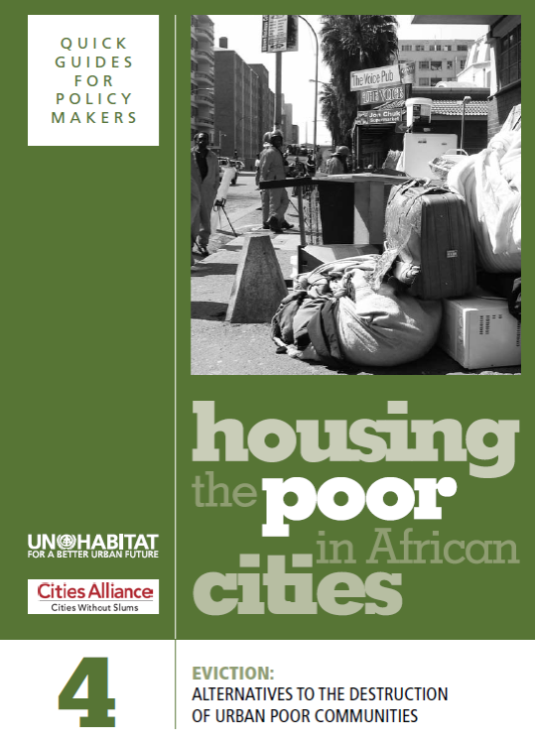
EVICTION

Slide 2
Learning Outcomes
Participants will be able to:
Understand causes of evictions and impacts on the lives and livelihoods of the urban poor
Describe the right to protection from forced evictions
Identify alternatives to forced evictions
Discuss obligations before, during and after eviction
2

Slide 3
Structure of the Module
Reasons for forced evictions and their impacts
Right to protection against forced evictions
Alternatives to evictions and ways to avoid evictions
Obligations before, during and after forced evictions
Useful trends and making use of housing knowledge in communities
3

Slide 4
Definitions
            Forced eviction: ‘The permanent or temporary removal against their will of individuals, families and/or communities from the homes and/or land they occupy, without the provision of, and access to, appropriate forms of legal or other protection’
              UNHCR (1997) CESCR General comment 7, The Right to Adequate Housing (Article 11.1: Forced Evictions)
Evictions that are not forced in the strictest legal sense but not voluntary either are usually in the form of negotiated removal
4

Slide 5
Five Reasons for Evictions
Increasing urbanization: spaces for informal settlements are appropriated
Large infrastructure projects: especially in order to attract investments
Market forces: through the liberalization of land markets and increasing pressure on informal settlements (‘gentrification’)
City ‘beautification’: cleaning up in order to attract investment
Ineffective laws and institutions: lack of legislation, procedures and related institutions to protect communities from eviction
5

Slide 6
Some ‘Facts’
The poor migrate to cities for good reasons
Cities need the poor to prosper
The poor have no choice but to live in informal settlements
Informal settlements are a solution to housing problems
>>Questions:
Are these really facts?
Do you agree with them?
6

Slide 7
Needs and Priorities of Poor Households
Location: being close to earning opportunities
Space for work: as well as for a home
Community support system: reliance on networks of family, friends, neighbours
Cost: no more than about 25-30 per cent of monthly income
>>Questions:
Do you agree with this list?
Could you add to this list?
7

Slide 8
How Eviction Affects the Poor
Poor communities are the greatest targets for eviction – and the worst prepared
Forced evictions lead to loss of investments into houses, belongings, earning opportunities and community support networks
They do not resolve housing shortages
Evictions are increasingly clearing public and private land for commercial development
8

Slide 9
Women and Forced Evictions
‘Governments need to recognise that, for women, housing often means much more than a roof over their heads.’
>>Questions:
What does ‘much more’ mean?
What is demonstrated in the film (and the handout) on an eviction in Port Harcourt about the impact on women?
What measure should be taken to minimise these impacts?
9

Slide 10
Eviction and HIV/AIDS
‘HIV and AIDS are a reality for urban and rural communities across Africa…Access to health care facilities, a stable supply of healthy food and clean water, and support from social networks in the settlement are all removed by eviction of the household, loss of their economic resources and destruction of the settlement.
Questions:
What are the particularly detrimental effects of eviction on people living with HIV/AIDS?
What measures should/could be taken to minimise these effects?
10

Slide 11
Tenure Security and Market Forces
‘…one of the paradoxes of social development and poverty alleviation programmes is that tenure insecurity can actually protect poor people from market forces. As soon as you make an informal settlement more secure by formalizing user rights or giving land title to its residents, those tiny plots which used to be insecure and unattractive suddenly enter the formal urban land market and become marketable commodities.’
>>Question:
Is this a valid argument?
Has it happened in your cities?
Can it be seen as a form of eviction?
11

Slide 12
Forced Evictions and the Law
‘Everyone has the right to a standard of living adequate for the health and well-being of himself and of his family, including food, clothing, housing and medical care and necessary social services...’
Article 25 of The Universal Declaration of Human Rights
‘The State itself must refrain from forced evictions and ensure that the law is enforced against its agents or third parties who carry out forced evictions.’
International Covenant on Economic, Social and Cultural Rights, General comment No. 7
                >>Question:
                To what extent are these principles being upheld in your country?
12

Slide 13
Right to Adequate Housing
Freedoms
Protection against forced evictions and the arbitrary destruction and demolition of one’s home
The right to be free from arbitrary interference with one’s home, privacy and family
The right to choose one’s residence, to determine where to live and to freedom of movement
Source: The United Nations Committee on Economic, Social and Cultural Rights
13

Slide 14
Right to Adequate Housing
Entitlements
Security of tenure
Housing, land and property restitution
Equal and non-discriminatory access to adequate housing
Participation in housing-related decision-making at the national and community levels
Source: The United Nations Committee on Economic, Social and Cultural Rights
14

Slide 15
Alternatives to Eviction
‘One of the best ways for cities to help their poor citizens access better housing and living conditions is by providing secure tenure in the informal settlements where they already live…and then working with them to upgrade their settlements together.’
>>Questions:
Why are almost all evictions preventable?
What alternatives are there to on-site upgrading?
15

Slide 16
Resettlement Guidelines
Involve the affected people
Support organization of communities
Provide information about the resettlement
Make use of best practices from other cities/countries
Survey the communities
Prepare the new plan
Select the new site
Prepare the new site
Organize the move
16

Slide 17
Seven Ways to Avoid Eviction
Recognise the poor are only trying to survive
Do not forcibly evict the poor from where they can provide their own shelter and livelihood
Listen to views of residents before making decisions
Support strengthening of community organizations
Prepare development plans in collaboration with poor communities
Introduce better land management and administration plans
Consider reviewing and reforming urban planning and eviction laws
>>Questions:
How realistic are these prescriptions?
What is the situation in your country?
17

Slide 18
Negotiating Tools for Avoiding Evictions
Community savings: giving access to greater financial resources
Community enumeration: poor people doing their own counting
Settlement mapping: making detailed settlement maps
House model exhibitions: building full-scale house designs
Negotiating with alternative plans: developing their own solutions
Land searching: finding vacant land
Shelter planning: participating in the planning process
Exchange learning: community-to-community exchanges
Network building: negotiating together
18

Slide 19
Obligations Before any Eviction Takes Place
All alternatives to eviction have to be considered first
All projects should incorporate an eviction impact assessment
Evictions must respect human rights and due processes
The rights to information, consultation and participation should be respected at all stages of the process
Legal and other remedies should be available at all times
Forced evictions should not result in homelessness
Adequate compensation needs to be provided in advance
All necessary measures should be taken to minimize the impact
19

Slide 20
Eviction Impact Assessment (EVIA)
Allows real cost of evictions to be understood
The cost of an eviction is more than the market value of the homes of the affected
EVIA should consider actions before, during and after the forced eviction process
Further guidelines exist on how to conduct EVIA
20

Slide 21
When Evictions are Unavoidable Ensure That:
Well-planned and clear procedures are in place
Evictees should not be coerced to destroy their dwellings and structures and should be given the opportunity of salvaging belongings
Evictions should not be carried out in a way that threatens the health or life of the evictees
Authorities are present
Persons carrying out the eviction are properly identified
Formal authorisation for eviction is given
Clear information is provided
21

Slide 22
After an Eviction
Need to monitor:
Needs of the evictees after the eviction
Impact of eviction on the community, in particular on their livelihood
Additional costs resulting from the relocation and because of the new site’s location
Sustainability and quality of the services
Possibilities for the community to sell and transport their products
Sustainability of the new site
Interaction with surrounding communities
Ensuring security of tenure
22

Slide 23
Trends to Make Use of
Decentralization: local authorities having greater freedom and more responsibility
Community organizations: having ‘grown, expanded and matured’
Partnerships: governments realizing the potential in working with community movements – instead of against them.
>>Questions:
Do you agree with such optimism?
What is the situation in your country with regard to the potential of decentralization and the relationships between local governments and community organizations?
23

Slide 24
Cities Have Their Own Housing Experts
‘Instead of hiring expensive consultants to tell them how to solve their housing problems, urban decision makers around the world are learning to look for assistance to the groups which are already providing most of the affordable housing in their cities – the poor themselves. It is no surprise that some of the best and most practical ideas for how to make housing programmes work…are originating from poor communities and their larger networks.’
>>Questions:
Do you agree with this statement?
How are communities participating in housing programmes in your countries?
24

Slide 25
Conclusions
Evictions have very detrimental effects on poor communities
Everyone is entitled to protection against forced evictions
There are many ways to try to avoid eviction
In the case of unavoidable eviction, it is important to follow internationally-established guidelines on obligations before, during and after evictions
25

