Slide 1
RESOURCE MOBILIZATION
January 2021

Slide 2
INCOME TRENDS BY FUND 2014-2020 and PERFORMANCE IN 2020 (as of31 December 2020)
TOTAL CONTRIBUTIONS | 10% higher income in 2020 than 2019: USD 208.2 million compared to USD 188.9 million
Regular Budget | UN-Habitat’s allocation from assessed contributions of Member States to UN System – shortfall in assessed contributions affects all agencies
Foundation Non earmarked | non-earmarked voluntary contributions for core normative activities; 2020 income only 21% of target of US18.9 million; urgent support from Member States for the budget of USD 10 million approved for 2021
EARMARKED CONTRIBUTIONS | Increase of 14% in demand for UN-Habitat’s services for earmarked programmes
Foundation Special Purpose | voluntary earmarked contributions for global programmes e.g., World Urban Forum, Global Land Tool Network: 57% higher in 2020, demand for UN-Habitat’s normative services; reached 84% of target for 2020
Technical Cooperation | voluntary earmarked contributions for country and regional programmes increase of 2.9% in 2020 showing continued demand for UN-Habitat services in countries, reached 94% of target for 2020

Slide 3
Resource Mobilization Strategy Objectives and Actions
1
2
ADEQUATE FUNDING
Regular budget: $ 60M
Non-earmarked: $ 41M
Normative earmarked:$ 262M
Country programmes: $ 607M
Total: $ 1,027M
Core contribution letters
Pledging sessions
Bilateral meetings
Regional Dialogues
Endowment fund
Soft earmarked packages
ALIGNMENT
Urban dimensions of the SDGs, NUA
UN-Habitat Strategic Plan
National strategic plans
UN Sustainable Development Cooperation Framework
UN Funding Compact
Regional structure
Common Country Assessments
Country focal points
Regional Dialogues
3
4
STRATEGIC PARTNERSHIPS
Joint strategy development
Multi-year agreements
Pooled funding
Large scale high impact programmes
Regional dialogues
Top donor engagement
Flagship programmes
Country programmes within UN system
DIVERSIFIED DONOR BASE
More Member States contributing
Domestic resources
Private Sector, Local Authorities, other
Multi-donor pooled funds
Private sector strategy
Foundations and Philanthropy Platform
Local Government engagement
Adaptation, Green Climate etc.
5
6
VALUE FOR MONEY
Results focused
Efficient
Transparent
Accountable
Monthly income updates to Member States
Urban Impact news
open.unhabitat.org
SOPs
Training for staff
Key performance Indicators
INNOVATION
Blended funding: loans, grants
National Committees
High Net Worth Individuals, Influencers
Technology support, social media
Endowment fund
Online fundraising
Crowdfunding

Slide 4
Foundation non earmarked resources
What
Foundation non earmarked
Member States’ role
Challenges
Challenges
Finances core activities e.g. urban research, data, policies, publications, guidelines, SDG monitoring
2021 budget USD 10 Million
Review and approve work programme and budget
Advise on actions to help mainstream core funding into Government budgets
Send core contribution letters and advocate for support from capital
Support and take part in strategic funding dialogues- bilateral and joint consultations
Take part in partnership and pledging events to increase core support
Income only 21% of budget in 2020
22 Member States contributed to core
Long term decline has impact on core activities

Slide 5
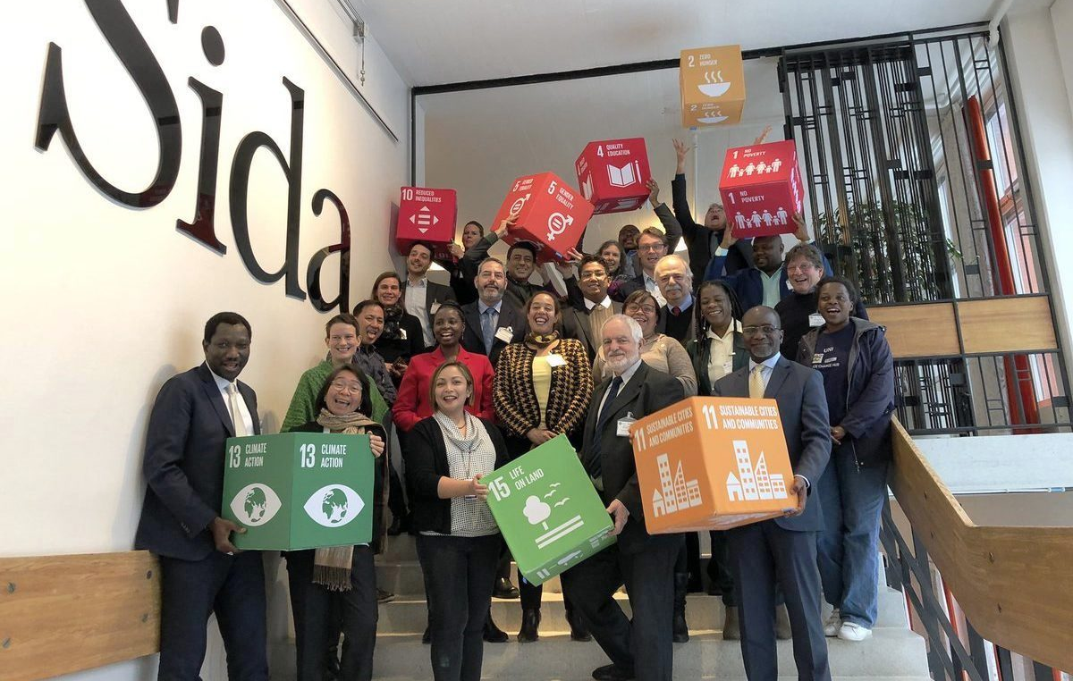
Foundation special purpose resources
What
Foundation special purpose
Member States’ role
Challenges
Challenges
Finances earmarked global programmes e.g. World Urban Forum, Participatory Slum Upgrading Programme, Global Land Tool Network
2021 budget USD 44 Million
Goals: balanced and soft earmarked support for all four domains of change
Review and approve work programme and budget
Share development aid strategy for your country
Advocate for support for thematic flagship programmes
Advocate for soft earmarked support

Slide 6
Technical Cooperation earmarked resources
What
Technical Cooperation
Member States’ role
Challenges
Challenges
Finances earmarked regional and country programmes top supporters are European Commission and Japan
2021 budget USD 164 Million
UN wide cooperation for high impact programmes to accelerate achievement of all SDGs in countries
Review and approve work programme and budget
Share development aid strategy for your country
Support for strengthening regional architecture and country presence
Take part in strategic Regional Dialogues
Support strategic dialogues with focal Ministries in your country

Slide 7
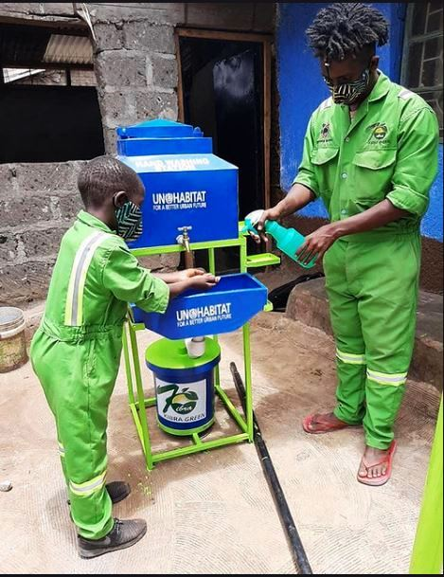
Programme Support Costs
What
Programme Support
Member States’ role
Challenges
Challenges
Covers indirect costs related to earmarked projects e.g. administrative support and advocacy
2021 budget USD 10.3 Million
Member States requested to comply with UN Secretariat cost recovery policies in line with UN Funding Compact
Ensures that core funds do not subsidize earmarked projects in line General Assembly Resolution A/RES/67/226 which requested implementation of full cost recovery

Slide 8
Resource Mobilization Strategy: Progress in 2020
Income acquisition
Engagement and communications
Strategies, innovation
Relationship management
Enabling environment
Standard Operating Procedures
Enhanced Donor Information System – Regional Profiles
Improved donor reporting
Key Performance Indicators
Donor Focal Point System
Private Sector
Foundations and Philanthropists
Endowment fund
Local Government engagement
Online giving (Donate button)
Regional Dialogues
Top donor engagement
Annual Donor Consultations
Urban Impact quarterly brief
Monthly financial updates
Pledging Session (December)
Core contribution letters
Earmarked grants 191.5M
Core contributions USD 4.3M
Support for COVID-19 USD 15.9M
7 |

Slide 9
Resource Mobilization Strategy – priorities moving forward
Increase level of core contributions and number of Member States contributing
Soft earmarked packages aligned to donor policies – including support for flagship programmes
UN-Habitat value proposition – compelling case to support mandate
Implementation of strategies to diversify donor base
Internal Capacity building on resource mobilization
Enhanced transparency – including upgrade of International Aid Transparency Initiative website open.unhabitat.org
8 |

Slide 10
Thank you!
www.unhabitat.org

