Slide 1
EXECUTIVE BOARD
Ad Hoc Working Group on
Programmatic, Budgetary, and Administrative Matters
Preparatory Session 21 October 2020
Gary Landes
Director (ai), Management, Advisory and Compliance Services
Tuesday, 27 October 2020

Slide 2
Agenda item 3: Financial, budgetary and administrative matters
Notes:
Support from Mexico and South Africa

Slide 3
| Agenda Item 3 – Contents
    Overview
    Supporting documents
    The financial status of UN-Habitat as at 30 June 2020 paragraph 4 of decision 2019, with an update as at 30 September 2020
    Update on the restructuring and financing of UN-Habitat
    Resource mobilization efforts including implementation of resource mobilization strategy
    Staffing status as at 30 June 2020, with an update as at 30 September 2020

Slide 4


| Agenda Item 3 – Overview
The overall financial support to UN-Habitat remains strong, specifically for the earmarked projects.
  The normative financial support to UN-Habitat does not support the full implementation of the 2020-2023 strategic plan, which has resulted in a reduction in the ability to fulfil the mandated normative outputs for 2020 and a reduced proposed programme of work for 2021.
  The above continues to leave UN-Habitat with unfunded areas, specifically in data collection and reporting in support of Agenda 2030 and the implementation of the Regional Architecture. In other areas there are many functions for which UN-Habitat is reliant on a single staff member to achieve significant mandated deliverables.

Slide 5
| Agenda Item 5 – Supporting documents
The following two documents are related to this agenda item:
    HSP/EB.2020/21: Report of the Executive Director on the financial status of UN-Habitat as at 30 June 2020
      Financial report and audited financial statements for the year ended 31 December 2019 and report of the Board of auditors (A/75/5/Add.9)
    HSP/EB.2020/21/Add.1: Report of the Executive Director on an update on the on-going restructuring of UN-Habitat
    HSP/EB.2020/21/Add.2: Report of the Executive Director on the staffing of UN-Habitat as at 30 June 2020
Tuesday, 27 October 2020

Slide 6

Financial Status of UN-Habitat
As at 30 June 2020
Updated interim status as at 30 September 2020

Slide 7
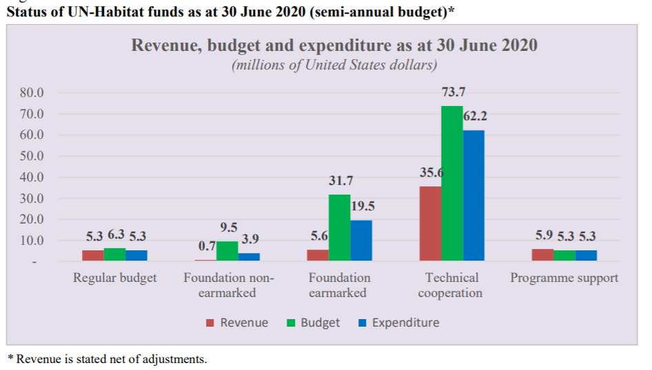
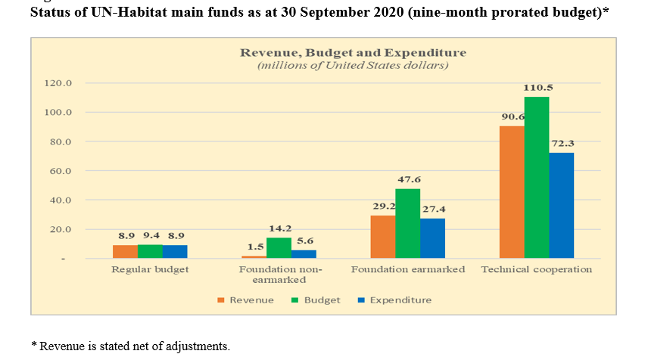
|Implications of reducing the Foundation non-earmarked budget on the work programme for 2021
Notes:
Approved by the General Assembly, the regular budget appropriation to UN-Habitat is provided under section 15 (Human settlements). In 2020, the final appropriation amounted to $12.5 million in the form of an authorization to expend against specific items within a set envelope. Approximately, 93 per cent of the $5.3 million expenditure recorded by 30 June 2020 relates to staff costs.
Approved by the General Assembly, the regular budget appropriation to UN-Habitat is provided under section 15 (Human settlements). In 2020, the final appropriation amounted to $12.5 million in the form of an authorisation to expend against specific items within a set envelope. Approximately, 94 per cent of the $8.9 million expenditure recorded by 30 September 2020 relates to staff costs. The UN Controller, has implemented liquidity restrictions, including a recruitment freeze on the vacant Regular Budget posts, and reduction in non-post costs of $810,000.
Foundation non-earmarked will be covered separately.
The approved budget for Foundation earmarked resources for 2020 is $63.5 million. The proportional budget relating to the reporting period is $31.7 million (equivalent to half of the approved budget for the year). As at 30 June 2020, the total revenue from Foundation earmarked voluntary contributions was $8.4 million from various donors. Total net revenue after refunds to donors and other prior year revenue adjustments amounted to $5.6 million,
The approved budget for Foundation earmarked resources for 2020 is $63.5 million. The proportional budget relating to the reporting period is $47.6 million (equivalent to nine months of the approved budget for the year). As at 30 September 2020, the total revenue from Foundation earmarked voluntary contributions was $32.1 million from various donors, as listed in annex III to the present report. Total net revenue after refunds to donors and other prior year revenue adjustments amounted to $29.2 million
The approved budget for technical cooperation for 2020 is $147.4 million. The budget for the reporting period amounted to $73.7 million (equivalent to half of the estimated budget for the year). As at 30 June 2020, the total revenue received was $35.6 million which included voluntary contributions of $32.0 million
The approved budget for technical cooperation for 2020 is $147.4 million. The budget for the reporting period amounted to $110.5 million (equivalent to nine months of the estimated budget for the year). As at 30 September 2020, the total revenue received was $90.5 million which included voluntary contributions of $86.8 million
The 2020 programme support budget approved by the Executive Director totaled $10.6 million. Programme support revenue as at 30 June 2020, excluding all other revenue, amounted to $5.9 million, against expenditure for the same period of $5.3 million, of which 42.8 per cent was used to fund posts.
The 2020 programme support budget approved by the Executive Director totaled $10.6 million. Programme support revenue as at 30 September 2020, excluding all other revenue, amounted to $7.7 million, against expenditure for the same period of $6.5 million, of which 47 per cent has been used to fund posts.

Slide 8
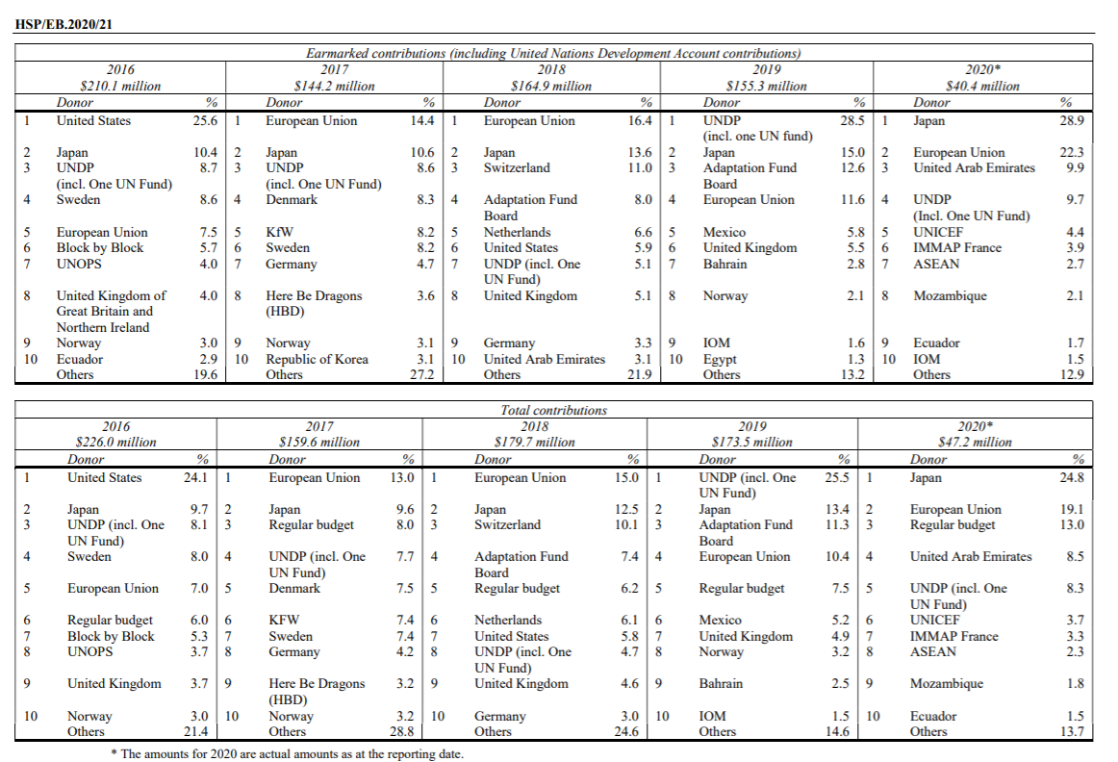
| Top 10 Earmarked Contributor 2016 – 2020 (as at 30 June 2020)

Slide 9
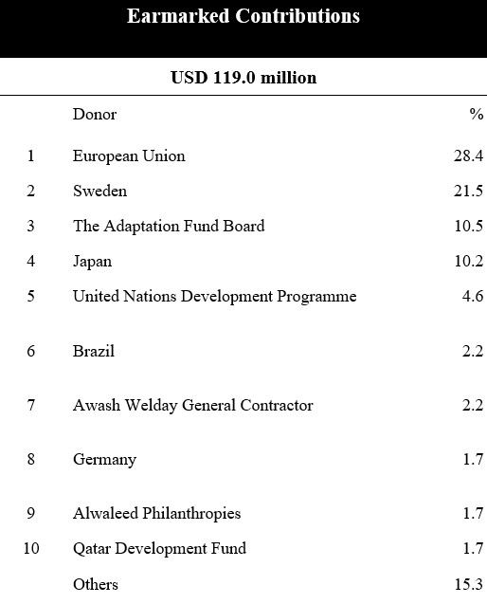
| Top 10 Earmarked Contributors 2020 (as at 30 September)
Notes:
UN-Habitat would like to acknowledge the top 10 earmarked contributors to both the normative work (Sweden soft-earmarked contribution and operational projects that benefit end beneficiaries globally.

Slide 10
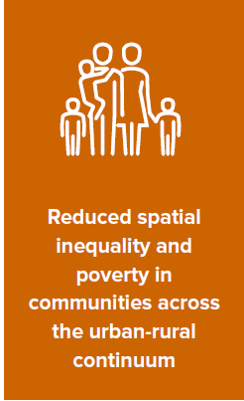
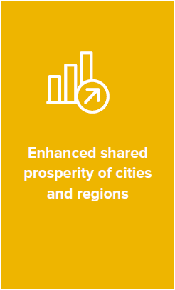
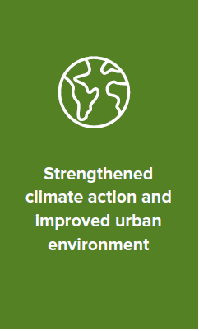
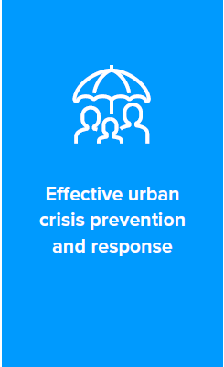
| Foundation non-earmarked contributions (as at 15 October 2020)
Country | 30 Sep. 2020
Algeria | 9 970
Barbados | 14 706
Botswana | 20 000
China | 350 000
Dominican Republic | 4 975
France | 227 740
Japan | 31 455
Korea, Republic of | 84 365
Malawi | 10 000
Myanmar | 9 980
Norway | 2 180 130
Pakistan | 5 941
Senegal | 44 868
South Africa | 150 000
Sri Lanka | 25 000
United States of America | 545 000
Total | 3 714 130
Notes:
UN-Habitat would like to acknowledge all the contributors to the normative work of the organization, which is key to maintain multilateralism
UN-Habitat promotes transformative change in cities and human settlements through knowledge, policy advice, technical assistance and collaborative action to leave no one and no place behind.

Slide 11
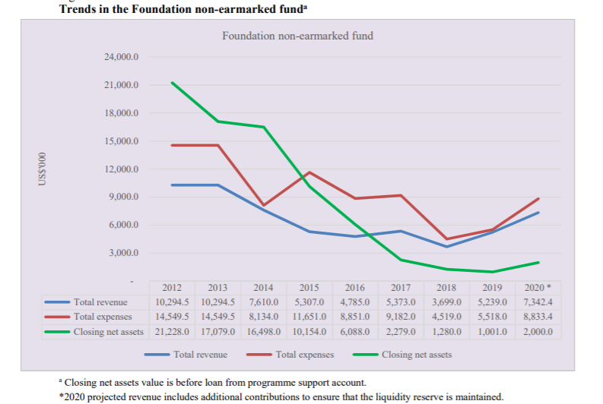
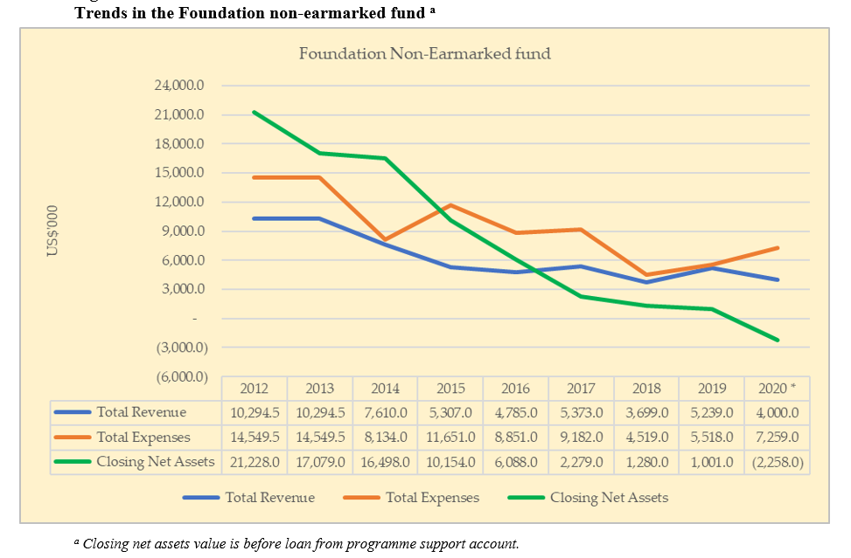
| Foundation Non-earmarked Contributions (30 June 2020 / 30 September 2020)
Notes:
Traditionally, the main source of Foundation non-earmarked revenue was non-earmarked contributions from Member States. The non-earmarked fund constitutes the main source of funding for the implementation of the UN-Habitat strategic plan for mandated normative work, required executive direction and management, and a baseline level of programme support.
The approved budget for this reporting period is $14.2 million (equivalent to nine months of the approved budget for 2020 of $18.9 million). Total voluntary contributions received as at 30 September 2020 amounted to $1.5 million, while expenditures for the same period totalled $5.6 million. The expenditures included $4.2 million on position costs and $1.4 million on operating expenditures, resulting in a net operational deficit of $4.1 million, and a requirement to cover operational expenditures for normative work using a short-term loan from the programme support cost fund.
A remaining statutory operational reserve of $1.9 million, as currently authorised, is based on 10 per cent of the $18.9 million approved budget for 2020.
Please be advised the Foundation non-earmarked Fund ended September 2020 with a negative cash position of $8k. UN-Habitat processed a short-term loan based on a pledge letter to cover the fund for October 2020. The loan is being repaid based on the contributions received in October 2020.
However, should all currently pledged contributions be received by 31 December 2020, the Foundation non-earmarked fund will end 2020 with a cash balance of less than $750k. We will revert to this matter in the context of agenda item 5 on the 2021 work programme and proposed budget.

Slide 12
    UN-Habitat 2019 Financial Statement and Board of Audit Report
October 2020

Slide 13
|UN-Habitat 2019 Financial Statements and Report of the Board of Auditors
  Key Facts noted in the Report of the Board of Auditors
  $ 25.6 million Original annual resources (regular budget and foundation non-earmarked)
  $227.15 million Original annual resources (technical cooperation and foundation special purpose)
  $172.3 million Total revenue
  $178.4 million Total expenses
  302 UN-Habitat staff
    Report of the Board of Auditors on the financial statements: audit opinion;
    In our opinion, the accompanying financial statements present fairly, in all material respects, the financial position of UN-Habitat as at 31 December 2019 and its financial performance and cash flows for the year then ended in accordance with the International Public Sector Accounting Standards (IPSAS).
    Overall conclusion
    The Board did not identify material deficiencies in accounts and records that might affect the fair presentation of the financial statements of UN-Habitat
Notes:
The United Nations Human Settlements Programme (UN-Habitat) is mandated by the General Assembly to promote socially and environmentally sustainable towns and cities. It is the focal point for all urbanization and human settlement matters within the United Nations system.
The Board of Auditors audited the financial statements and reviewed the operations of UN-Habitat for the year ended 31 December 2019. The audit was carried out at UN-Habitat headquarters in Nairobi from 7 to 30 October 2019; at the Regional Office for Asia and the Pacific in Fukuoka, Japan, from 25 November to 12 December 2019; at the Myanmar country office in Yangon, from 25 November to 13 December 2019; and at the Philippines country office in Manila and the Sri Lanka country office in Colombo, both from 13 to 30 January 2020.
Since 13 April 2020, the Board has conducted the audit remotely owing to the coronavirus disease (COVID-19) pandemic. This included the final audit of the financial statements.

Slide 14
| UN-Habitat 2019 Financial Statements and Report of the Board of Auditors
  Key Findings noted in the Report of the Board of Auditors
  Low implementation rate for previous year’s audit recommendations.
  Agreements signed and accrued in different years
  Validity of agreements of cooperation and their amendments
  Maximum amount of community agreements
  Formal instruction for the recruitment, process done through a non-United Nations entity
  Recruitment process done through a non-United Nations entity
  Overtime of staff members at UN-Habitat headquarters
Notes:
UN-Habitat would like to acknowledge the work with the Chilean BOA Auditors who completed their term following the 2019 Financial Statement Audit and we have been working with the Chinese BOA who have commenced their term.
UN-Habitat acknowledges that we have a capacity issue in the area of internal oversight and audit. We have one dedicated Accountant / Former Auditor overseeing the annual audits of the BOA, OIOS, EU Verifications, and periodic Joint Inspection Unit reviews. The staff in MACS provide on-going support complimented by our accounting service provider UNON, but given the breath of our operations we were endeavouring to strengthen this area, but the funding is currently not available.
UN-Habitat would like to update the members of the Executive Board (Ad Hoc Working Group on Programmatic, Budgetary, and Administrative matters on the key findings of the BOA:
We have taken action to ensure all contribution agreements signed by those with Delegation of Authority transmit the agreements in a timely manner to MACS. Additionally, we have updated our year-end review procedure with UNON a secondary check to ensure full compliance with IPSAS revenue recognition;
We have through the restructuring of Programme Management Officers / Assistants to MACS have re-emphasized the importance of reviewing all Implementing Partner delivery and reporting schedules to ensure any necessary amendments are enacted in a timely manner. We do not have there have been some exceptions during the COVID-19 pandemic of amendments being requested as the agreement terms have ended.
We are updating our internal procedures on the thresholds for community agreements as part of our working on programme / project operational guidance.
MACS has strengthened our Human Resources Unit in a limited manner to address the issues of personnel provided through service providers. We also note there are specific security issues related to our service providers for Afghanistan and Iraq that have limited our options.
The overtime / compensatory time off issue was a result of two main issues: Support provided to the First UN-Habitat Assembly and fact on Friday’s in Kenyan there is a shortened work-day, which impacts the application of CTO prior to OT. UN-Habitat has worked with both UNON our servicer provider and UNHQ: UNON is awaiting the updated Administrative Instruction (AI) from UN Headquarters on working hours, overtime and compensatory time off before altering the current Information Circular.

Slide 15
    Update on the restructuring and financing of UN-Habitat
October 2020

Slide 16
|Update on the organizational restructuring of UN-Habitat
November 2019: Executive Board endorsed Habitat’s new organisational structure
January 2020: Staff members were laterally reassigned to organisational units in the new structure
UN-Habitat Regional Architecture Working Group Established
The Executive Director has established a working group tasked to develop a strategy and guiding principles to strengthen Habitat’s global presence to maximize country-level impact.
It is well recognized that UN-Habitat’s technical advisory and other country-level activities enhance the normative value of the policies, guidelines and other tools developed and championed by the organization.
Normative work is defined by the United Nations Evaluations Group as:
“ The support to the development of norms and standards in conventions, declarations, regulatory frameworks, agreements, guidelines, codes of practice and other standard setting instruments at global, regional and national level. Normative work also includes the support to the implementation of these instruments at the policy level, i.e., their integration into legislation, policies and development plans, and to their implementation at the programme level. ”

Slide 17
|Update on the organizational restructuring of UN-Habitat
Guiding principle: one size does not fit all; significant variation exists between countries and regions. Moreover, Habitat has finite resources and cannot operate in the same manner in all locations globally.
In addition to headquarters, the working group has identified six possible typologies of presence:
Regional Office
Country Office
Liaison Office
Global programme office/thematic hub
Project office/other forms of country-level programme presence
Fundamental elements and functions for each typology, e.g., a regional/country office or liaison/representational office are presently being developed by the working group
Notes:
Global programme office/thematic hub (Global Water Operators' Partnerships Alliance (GWOPA)

Slide 18
|Update on the organizational restructuring of UN-Habitat
Guiding principle: enhanced alignment and integration at all levels with the reformed United Nations Development System (UNDS) to ensure wider UN regional leverage and system wide coordination engagement
UNDS system reforms
Strengthen engagement with the new Resident Coordinator system and active participation in United Nations Country Teams (UNCTs), including the Common Country Assessment and Cooperation Framework process
  Presently UN-Habitat’s participation is negatively impacted by the fact that many of our country and programme offices away from headquarters operate with very limited human resources
Facilitate cooperation and collaboration with the regional UN Development Coordination Office (UN DCO) and the Regional Collaborative Platforms

Slide 19
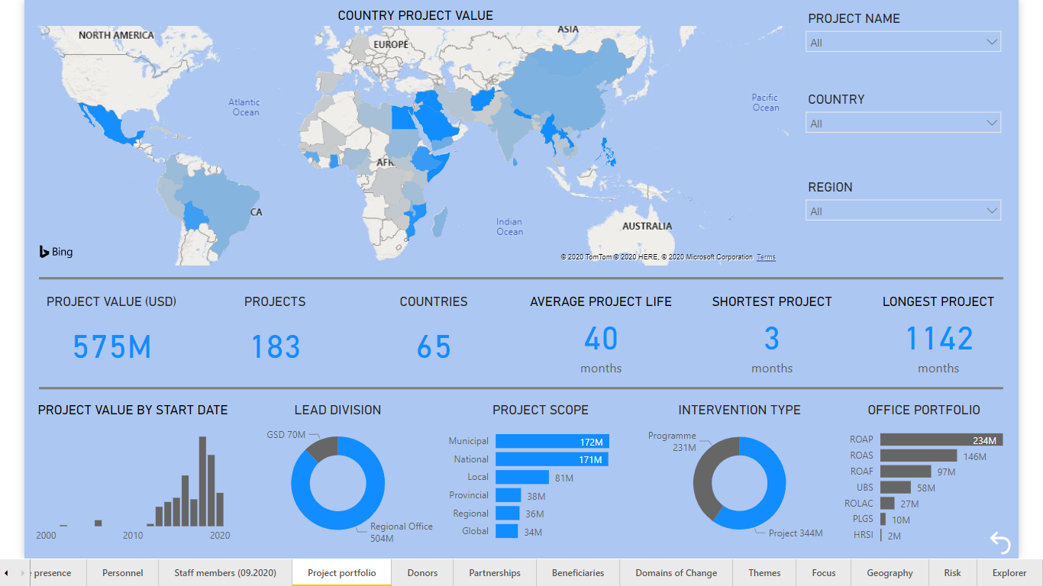
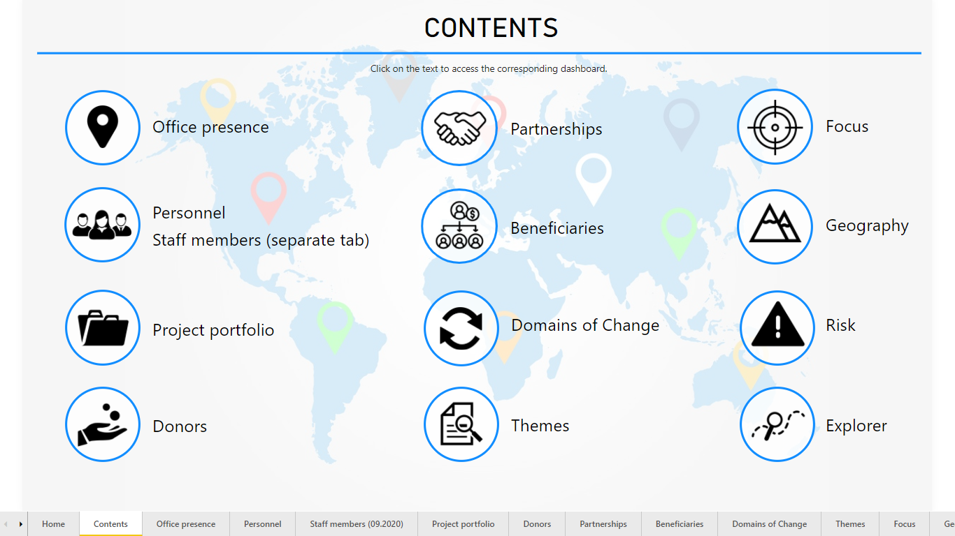
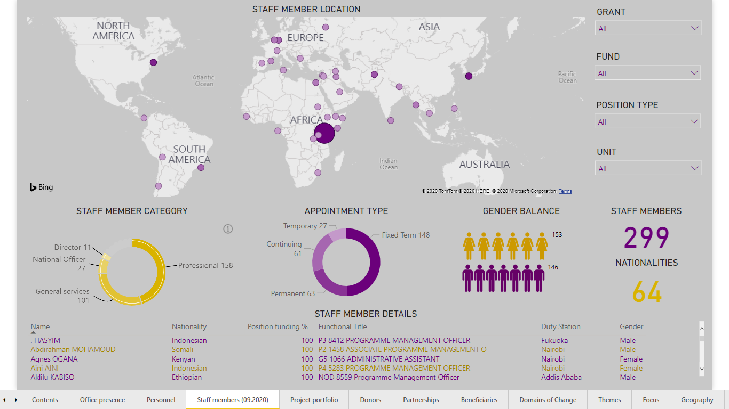
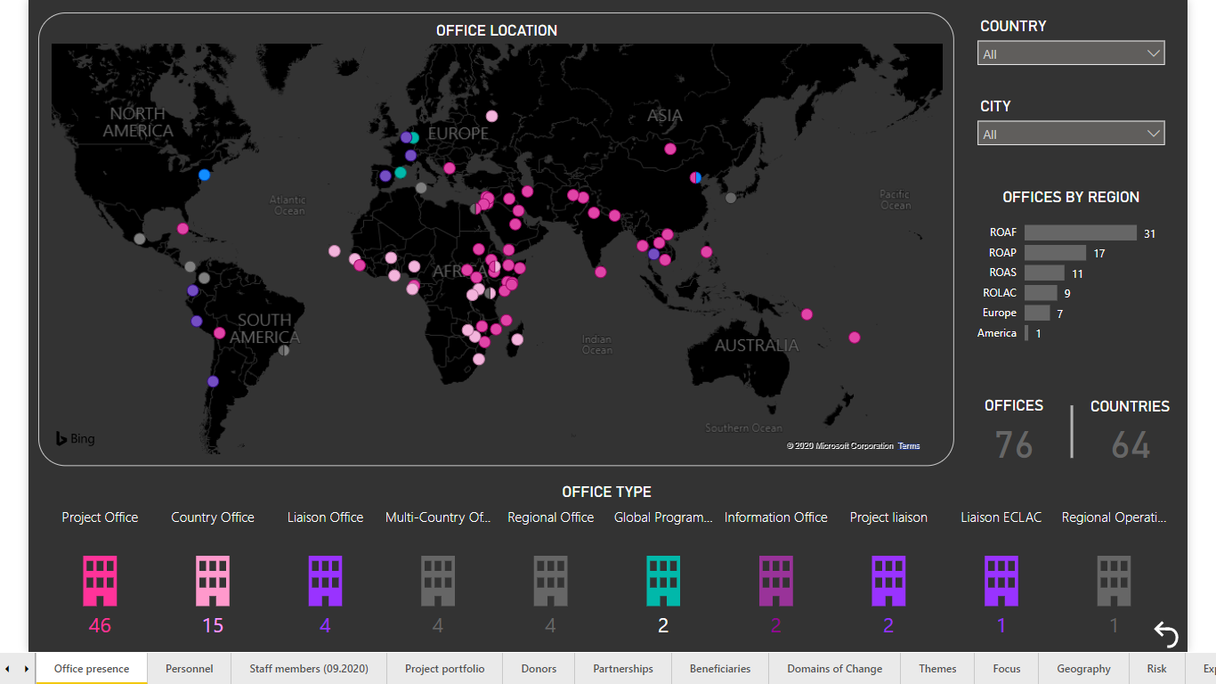
|Update on the organizational restructuring of UN-Habitat
Mapping UN-Habitat’s global presence
An interactive ‘Global Dashboard’ is under development to visualize UN-Habitat’s global presence and operations in the field.

Slide 20
|Update on the organizational restructuring of UN-Habitat
Parallel two-track approach to implementation
Track 1: ‘quick wins’ to strengthen Habitat’s current country-level presence and regional engagement by assigning staff to strategic locations [e.g. locations hosting a regional UN DCO or Economic Commission]; bolstering the human resources capacities/realigning the mandate of existing offices [e.g. a Country Office could also provide liaison services]
Track 2: establish new UN-Habitat offices; this could take the form of a new regional or country office, or an office mandated to host an UN-Habitat global programme
Establishment of a new office away from headquarters will be subject to the Secretary-General’s December 2019 directive on ‘Procedures for the Establishment of United Nations Offices away from Headquarters’

Slide 21
RESOURCE MOBILIZATION STRATEGY
October 2020

Slide 22






Resource Mobilization Strategy Objectives and Actions
1
2
  TARGET FUNDING
  Regular budget: $ 60M
  Non-earmarked: $ 41M
  Normative earmarked:$ 262M
  Country programmes: $ 607M
  Total: $ 1,027M
Core contribution letters
Pledging sessions
Bilateral meetings
Endowment fund
Monthly updates to MS
Soft earmarked packages
  ALIGNMENT
  Urban dimensions of the SDGs, NUA
  UN-Habitat Strategic Plan
  National strategic plans
  UN Sustainable Development Cooperation Framework
  UN Funding Compact
Regional dialogues
Country focal points
Value proposition
3
4
  STRATEGIC PARTNERSHIPS
  Joint strategy development
  Multi-year agreements
  Pooled funding
  Large scale high impact programmes
Value proposition
Regional dialogues
Top donor engagement
Flagship programme financing mechanism
Donor intelligence
  DIVERSIFIED DONOR BASE
  More Member States contributing
  Domestic resources
  Private Sector, Local Authorities, other
  Multi-donor pooled funds
Private sector strategy
Foundations and Philanthropy platform
Local Government engagement
5
6
  VALUE FOR MONEY
  Results focused
  Efficient
  Transparent
  Accountable
Value proposition
open.unhabitat.org
Urban Impact
Key Performance Indicators
Training for staff
  INNOVATION
  Blended funding: loans, grants
  National Committees
  High Net Worth Individuals, Influencers
  Technology support, social media
Endowment fund
Donate Button
Crowdfunding
Notes:
The main objective of the resource mobilization strategy is to enhance predictable, flexible and long-term funding to implement approved activities in UN-Habitat’s strategic plan. Special focus is given to core funding where a significant shortfall between the approved budget remains.
Our resource mobilization actions ensure that funds raised are aligned to our strategic plan and implementation of global urban agenda, national development strategies as agreed through the UN Resident Coordinator System and our with governments, and following the principles of the UN Funding Compact agreed between the Secretary General and Member States in 2019.
We shall continue to work towards strategic relations with development partners to achieve transformative change through multi-year programmes, funded, where possible by multiple donors so that we can leverage their resources and deliver at scale.
In addition to increasing the level of financial support for urban programmes the strategy is aimed is at diversifying the number and types of donors to minimize risk and secure broad ownership of our mandate. To do this we shall look at innovative approaches including domestic fundraising in emerging economies and greater use of technology to enhance support for urban initiatives
Finally, we shall continue to strive to be results focused, efficient, transparent and accountable to maximize value for tax payers’ money.

Slide 23
| Resource Mobilization Strategy: Progress in 2020
Income acquisition
Engagement and communications
Strategies, innovation
Relationship management
Enabling environment
Standard Operating Procedures
Enhanced Donor Information System – Regional Profiles
Improved donor reporting
Key Performance Indicators
Donor Focal Point System
Private Sector
Foundations and Philanthropists
Endowment fund
Local Government engagement
Online giving (Donate button)
Regional Dialogues
Top donor engagement
Annual Donor Consultations
Urban Impact quarterly brief
Monthly financial updates
Pledging Session (December)
Core contribution letters
Earmarked grants 130 M
Core contributions USD 4M
Support for COVID-19 USD 15.9M
22 |
Notes:
The proposed strategy has gone through reviews by Member States and their proposed changes have been incorporated in the latest version shared with you.
Based on the strategy, an action plan for 2020-2021 was drawn up. Achievements so far include over USD 130 million mobilized for earmarked programmes including support for Covid-19 – we appeal for your support to bridge the gap between the USD 4 million received in core funds against the annual target of USD 18.9 million.
To enhance our understanding with regional specificities and requirements, the Executive Director has held dialogues with Regional Groups and continues to engage with Member States and other development partners on a bilateral basis, and a donor focal point system has been established to ensure we maintain close and good relations with development partners and respond to their needs.
To improve communications, monthly income statements are now sent to Member States, starting this month, our Urban Impact quarterly brief is shared with some 14,000 partners including 800 donors, providing updates on the impact of the work that the collaboration with our partners makes possible worldwide.
To diversify our donor base, strategies and initiatives on enhancing engagement with the private sector, foundations, local governments and online donations is under development.
And strengthen the capacity of our staff standard operating procedures and enhanced systems support the efforts continue to be updated and improved.

Slide 24
| Resource Mobilization Strategy – priorities moving forward
Increase level of core contributions and number of contributors
Soft earmarked packages aligned to donor policies
Appeal and value proposition document
Implementation of strategies to diversify donor base
Enhanced International Aid Transparency Initiative website open.unhabitat.org
Capacity building on resource mobilization
23 |
Notes:
Moving forward, we continue to prioritize increasing the level of core funding because this allows the organization to remain a center of excellence on urban matters and to develop global norms and policy which is the basis of the support we are able to offer countries in terms of development of national and local policies and urban programmes to help them achieve the urban dimensions of the SDGs
In view of the challenges in securing totally unearmarked funding due to some national policies, we are developing soft earmarked packages to enable Member States to provide support at thematic level or to strengthen our regional structures so that we can better serve Member States
We are also making efforts to better demonstrate value for money and the impact of our work by improving our compliance with the International Aid Transparency Initiative by linking our work with the global urban agenda and further the enhance the capacity of our staff.
We appeal for your support to enhance investment and financial support for deliver of our strategic plan and achievement of urban agenda so that together we can improve the quality of life for all in an urbanizing world.

Slide 25
    Staffing status as at 30 June 2020, with an update as at 30 September 2020
October 2020

Slide 26
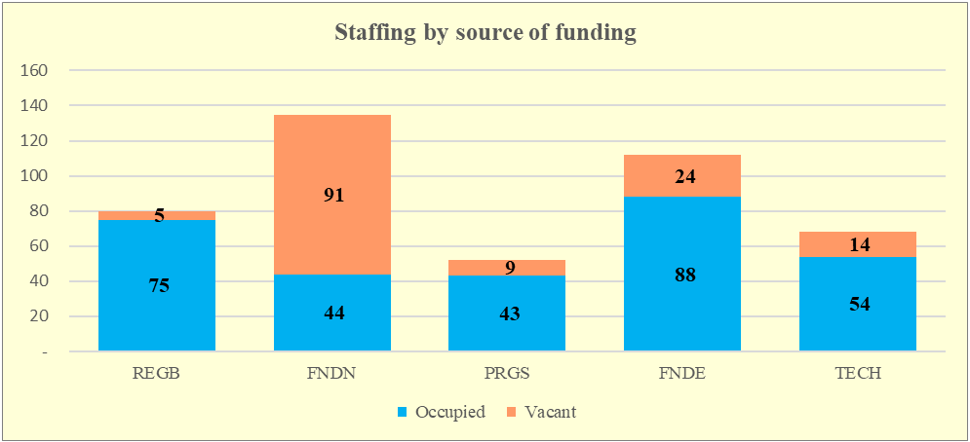
| Staffing status as at 30 June 2020
Post distribution by funding segment
Abbreviations: Appr. = approved; Occ. = occupied; Vac. = vacant; Pct. = percentage of occupancy.
 | Professional category and above |  |  |  |  | General service |  |  |  |  | Total
Funding source | Appr. | Occ. | Vac. | Pct. |  | Appr. | Occ. | Vac. | Pct. |  | Appr. | Occ. | Vac. | Pct.
Foundation non-earmarked | 93 | 23 | 70 | 24.7 |  | 42 | 21 | 21 | 50.0 |  | 135 | 44 | 91 | 32.6
Regular budget | 52 | 48 | 4 | 92.3 |  | 28 | 27 | 1 | 96.4 |  | 80 | 75 | 5 | 93.8
Programme support | 31 | 25 | 6 | 80.6 |  | 21 | 18 | 3 | 85.7 |  | 52 | 43 | 9 | 82.7
Foundation earmarked | 73 | 55 | 18 | 75.3 |  | 39 | 33 | 6 | 84.6 |  | 112 | 88 | 24 | 78.6
Technical cooperation | 62 | 48 | 14 | 77.4 |  | 6 | 6 | – | 100.0 |  | 68 | 54 | 14 | 79.4
Total | 311 | 199 | 112 | 64.0 |  | 136 | 105 | 31 | 77.2 |  | 447 | 304 | 143 | 68.0
25 |
*Abbreviations: REGB = regular budget; FNDN = Foundation non-earmarked; PRGS = programme support; FNDE = Foundation earmarked; TECH = technical cooperation.
Notes:
Moving forward, we continue to prioritize increasing the level of core funding because this allows the organization to remain a center of excellence on urban matters and to develop global norms and policy which is the basis of the support we are able to offer countries in terms of development of national and local policies and urban programmes to help them achieve the urban dimensions of the SDGs
In view of the challenges in securing totally unearmarked funding due to some national policies, we are developing soft earmarked packages to enable Member States to provide support at thematic level or to strengthen our regional structures so that we can better serve Member States
We are also making efforts to better demonstrate value for money and the impact of our work by improving our compliance with the International Aid Transparency Initiative by linking our work with the global urban agenda and further the enhance the capacity of our staff.
We appeal for your support to enhance investment and financial support for deliver of our strategic plan and achievement of urban agenda so that together we can improve the quality of life for all in an urbanizing world.

Slide 27
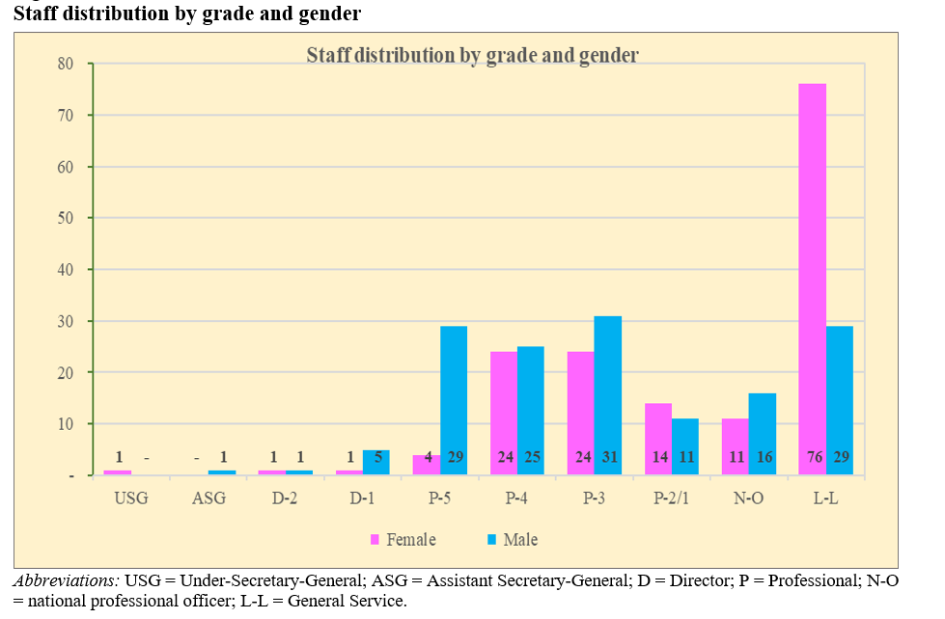
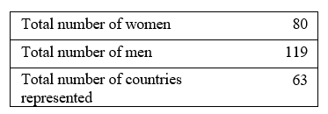
| Staffing status as at 30 June 2020
Professional Posts
26 |
*Abbreviations: REGB = regular budget; FNDN = Foundation non-earmarked; PRGS = programme support; FNDE = Foundation earmarked; TECH = technical cooperation.
Notes:
Moving forward, we continue to prioritize increasing the level of core funding because this allows the organization to remain a center of excellence on urban matters and to develop global norms and policy which is the basis of the support we are able to offer countries in terms of development of national and local policies and urban programmes to help them achieve the urban dimensions of the SDGs
In view of the challenges in securing totally unearmarked funding due to some national policies, we are developing soft earmarked packages to enable Member States to provide support at thematic level or to strengthen our regional structures so that we can better serve Member States
We are also making efforts to better demonstrate value for money and the impact of our work by improving our compliance with the International Aid Transparency Initiative by linking our work with the global urban agenda and further the enhance the capacity of our staff.
We appeal for your support to enhance investment and financial support for deliver of our strategic plan and achievement of urban agenda so that together we can improve the quality of life for all in an urbanizing world.

Slide 28
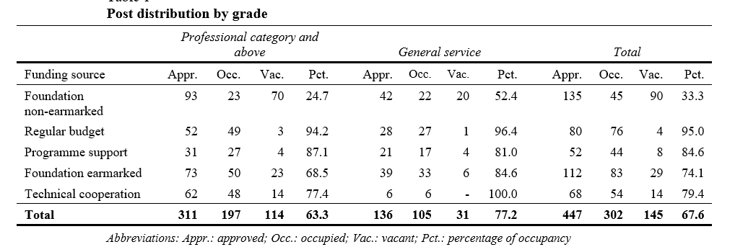
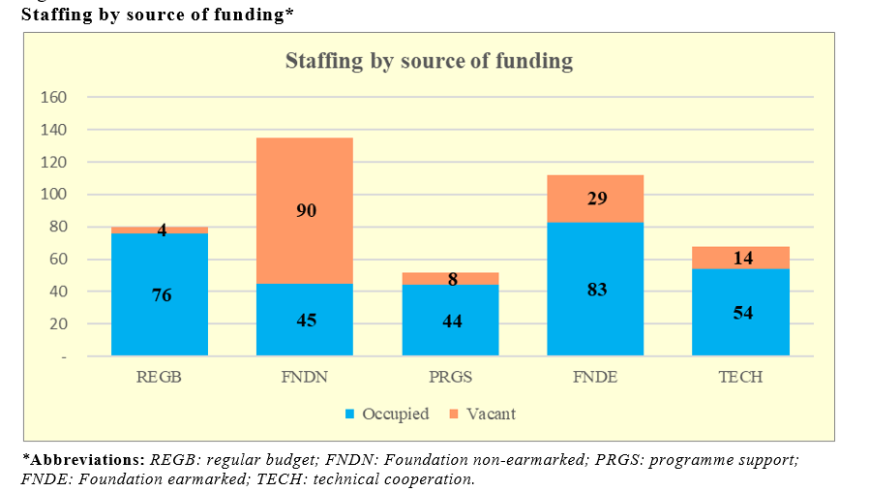
| Staffing status as at 30 September 2020
27 |
*Abbreviations: REGB = regular budget; FNDN = Foundation non-earmarked; PRGS = programme support; FNDE = Foundation earmarked; TECH = technical cooperation.
Notes:
Moving forward, we continue to prioritize increasing the level of core funding because this allows the organization to remain a center of excellence on urban matters and to develop global norms and policy which is the basis of the support we are able to offer countries in terms of development of national and local policies and urban programmes to help them achieve the urban dimensions of the SDGs
In view of the challenges in securing totally unearmarked funding due to some national policies, we are developing soft earmarked packages to enable Member States to provide support at thematic level or to strengthen our regional structures so that we can better serve Member States
We are also making efforts to better demonstrate value for money and the impact of our work by improving our compliance with the International Aid Transparency Initiative by linking our work with the global urban agenda and further the enhance the capacity of our staff.
We appeal for your support to enhance investment and financial support for deliver of our strategic plan and achievement of urban agenda so that together we can improve the quality of life for all in an urbanizing world.

Slide 29
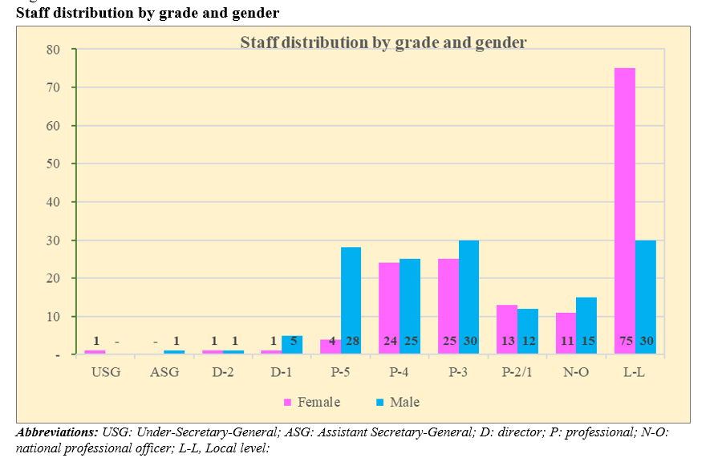
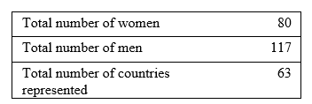
| Staffing status as at 30 September 2020
Professional Posts
28 |
*Abbreviations: REGB = regular budget; FNDN = Foundation non-earmarked; PRGS = programme support; FNDE = Foundation earmarked; TECH = technical cooperation.
Notes:
Moving forward, we continue to prioritize increasing the level of core funding because this allows the organization to remain a center of excellence on urban matters and to develop global norms and policy which is the basis of the support we are able to offer countries in terms of development of national and local policies and urban programmes to help them achieve the urban dimensions of the SDGs
In view of the challenges in securing totally unearmarked funding due to some national policies, we are developing soft earmarked packages to enable Member States to provide support at thematic level or to strengthen our regional structures so that we can better serve Member States
We are also making efforts to better demonstrate value for money and the impact of our work by improving our compliance with the International Aid Transparency Initiative by linking our work with the global urban agenda and further the enhance the capacity of our staff.
We appeal for your support to enhance investment and financial support for deliver of our strategic plan and achievement of urban agenda so that together we can improve the quality of life for all in an urbanizing world.

Slide 30

Thank you!
www.unhabitat.org

